Slide 1
Few-shot learning in NLP
Dawid Przybyliński, Aleksander Podsiad, Piotr Sieńko
Notes:
Pioter

Slide 2
Few-shot learning
Deep learning requires huge amount of data to train
Labelling the data is costly and time consuming
Efficient techniques for undersized samples are needed
Few-Shot Methods
Notes:
Pioter

Slide 3
Few-shot learning methods
Semi-supervised learning
Active learning
Transfer learning
Data augmentation
Contrastive learning
Notes:
Pioter

Slide 4
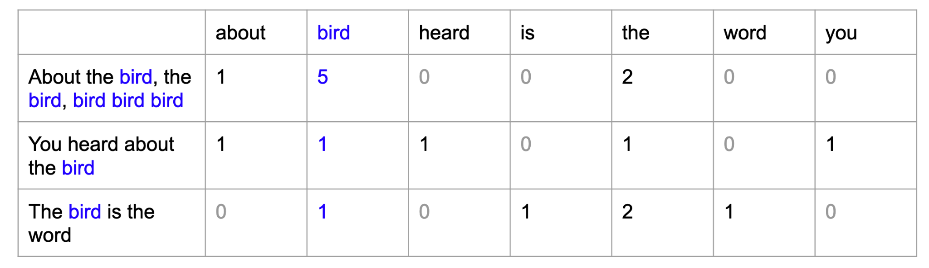
Text vector representation
Bag-of-Words
https://openclassrooms.com/en/courses/6532301-introduction-to-natural-language-processing/6980811-apply-a-simple-bag-of-words-approach
2. Pre-trained model such as BERT
Notes:
Dawid

Slide 5
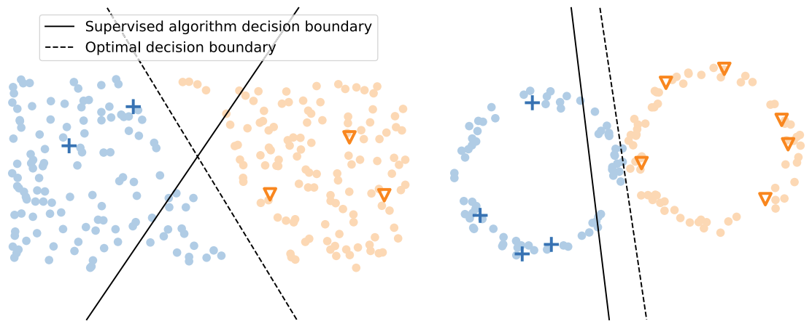
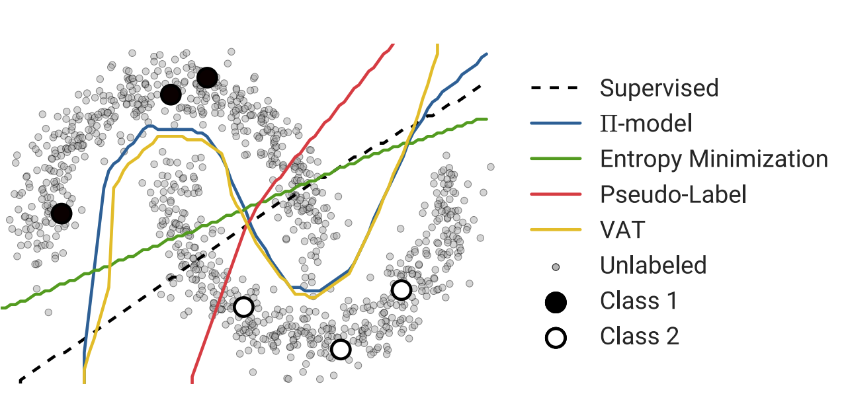
Semi-supervised learning
Using unlabeled observations to analyse the real structure of data
Realistic Evaluation of Deep Semi-Supervised Learning Algorithms (Oliver, Odena, Raffel, Ekin D. Cubuk & Ian J. Goodfellow)
A survey on semi-supervised learning (Van Engelen, Jesper E and Hoos, Holger H)
Notes:
Dawid

Slide 6
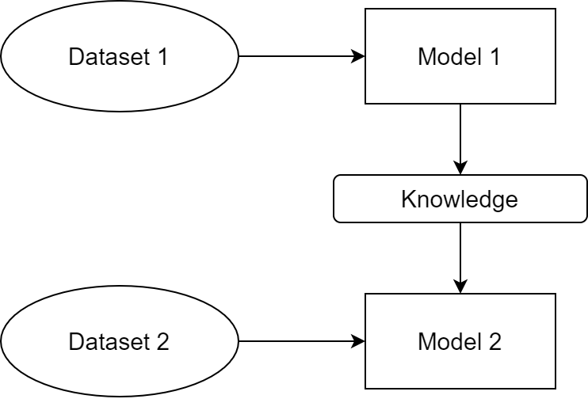
Transfer learning
Using knowledge gained from similar problem
Notes:
Olek

Slide 7
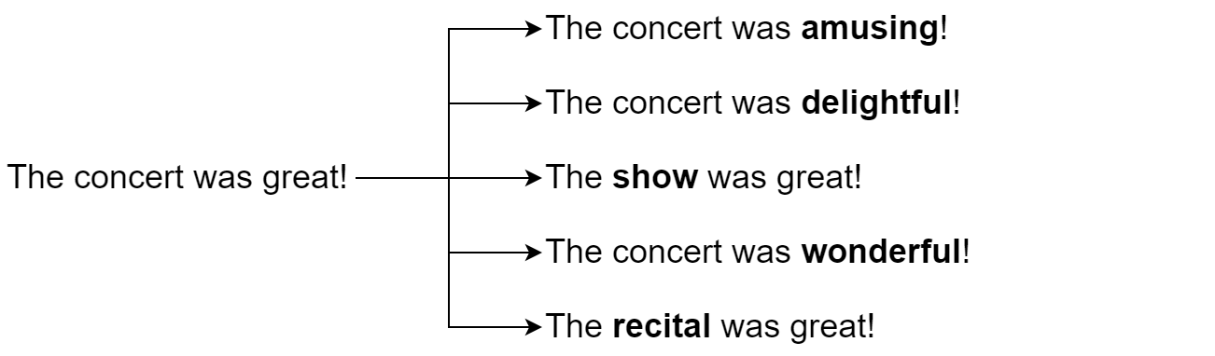
Data augmentation
Synonyms
Notes:
Olek

Slide 8
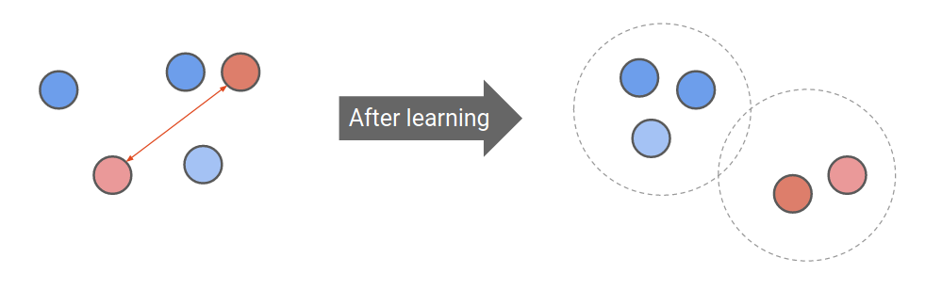
Contrastive learning
Having positive and negative examples, create such an embedding, that distance between instances from the same class is minimized and distance to different classes is maximized
Source: Lilian Weng, Jong Wook Kim, NeurIPS 2021
Notes:
Pioter

Slide 9
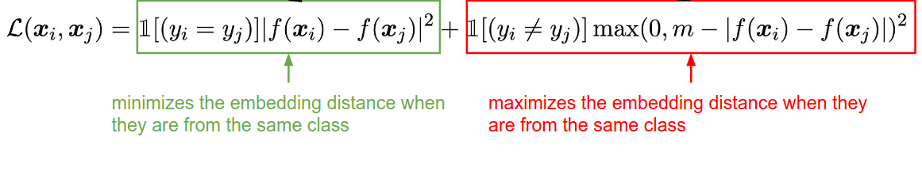
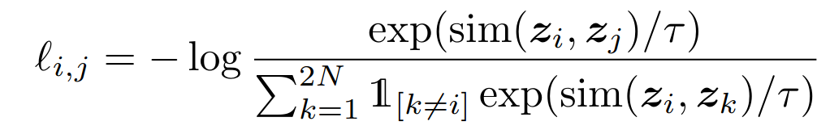
Contrastive learning loss functions
Basic Contrastive Loss:
Normalized Temperature-scaled Cross Entropy Loss (with cosine similarity):
Source: R. Zhang et al, NAACL 2022
Source: Chen et al. 2022
Notes:
Pioter

Slide 10
Project plan
First part:
Bag-of-words
contrastive learning
semi-supervised
augmentation
loss functions
Second part:
BERT
transfer learning
loss functions
augmentation
modifications
Notes:
Dawid

Slide 11
Data sources
IMDb: Large Movie Review Dataset - 25,000 training, 25,000 test
Amazon Review Polarity Dataset - 1,800,000 training, 200,000 test
Yelp Review Polarity Dataset - 280,000 training, 19,000 test
Notes:
Olek

Slide 12
References
Generalizing from a Few Examples: A Survey on Few-Shot Learning (Wang, Yao, Kwok, Ni, 2020) https://arxiv.org/abs/1904.05046
Distributed Representations of Words and Phrases and their Compositionality (Mikolov, Sutskever, Chen, Corrado, Dean) http://arxiv.org/abs/1310.4546
X. Zhang and J. Zhao and Y. LeCun 2015. Character-level Convolutional Networks for Text Classification, https://doi.org/10.48550/arXiv.1509.0162
Lilian Weng, Jong Wook Kim, Self-Supervised Learning: Self-Prediction and Contrastive Learning, NeurIPS 2021, https://neurips.cc/media/neurips-2021/Slides/21895.pdf
Zhang et al. Contrastive Data and Learning for Natural Language Processing, NAACL 2022, https://contrastive-nlp-tutorial.github.io/files/contrastive_nlp_tutorial.pdf
A survey on semi-supervised learning (Van Engelen, Jesper E and Hoos, Holger H) https://doi.org/10.1007/s10994-019-05855-6
Realistic Evaluation of Deep Semi-Supervised Learning Algorithms (Oliver, Odena, Raffel, Ekin D. Cubuk & Ian J. Goodfellow) https://arxiv.org/abs/1804.09170
Chen et al. A Simple Framework for Contrastive Learning of Visual Representations, 2022
Applying SoftTriple Loss for Supervised Language Model Fine Tuning (Sosnowski, Wróblewska, Gawrysiak, 2021) https://arxiv.org/abs/2112.08462.

